Slide 1
SQL PROJECT
Chukwuemeka Reginald Nkwocha

Slide 2
Creating the table
/* The first step is to create the tables The IPL_matches1 table and ipl_ball table from the excel csv dataset*/
create table IPL_matches1( id INT PRIMARY KEY, city VARCHAR, date DATE, player_of_match VARCHAR, venue VARCHAR, neutral_venue BOOLEAN, team1 VARCHAR, team2 VARCHAR, toss_winner VARCHAR, toss_decision VARCHAR, winner VARCHAR, result VARCHAR, result_margin INT, eliminator VARCHAR, method VARCHAR, umpire1 VARCHAR, umpire2 VARCHAR);
SET datestyle = 'ISO, DMY’;
copy ipl_matches1 from 'C:/Program Files/PostgreSQL/16/data/IPL Dataset/IPL_matches.csv' delimiter ',' CSV HEADER
select * from ipl_matches1;
create table IPL_Ball ( id INT, inning INT, over INT, ball INT, batsman VARCHAR, non_striker VARCHAR, bowler VARCHAR, batsman_runs INT, extra_runs INT, total_runs INT, is_wicket BOOLEAN, dismissal_kind VARCHAR, player_dismissed VARCHAR, fielder VARCHAR, extras_type VARCHAR, batting_team VARCHAR, bowling_team VARCHAR);
copy IPL_Ball from 'C:/Program Files/PostgreSQL/16/data/IPL Dataset/IPL_Ball.csv' delimiter ',' CSV HEADER
select * from ipl_ball;

Slide 3
First Priority to get 2-3 players with high Strike Rate who have faced at least 500 balls
In this analysis, we are looking for 2-3 players with a high strike rate who have faced at least 500 balls. We need to identify 10 players to help me make the right decisions regarding my finances and the bid I am making for an aggressive IPL player.
The following code will do:
calculate total runs and the ball faced by each batsman.
It will also calculate the strike Rate and filter Batsmen with at least 500 balls faced.
finally it will give top 10 batsmen by strike rate.
considering that extras_type is not counted either as ball faced or as batmans run

Slide 4
First Priority codes
select batsman,sum(batsman_runs) as total_runs,count(*) filter (where extras_type != 'wides') as balls_faced,Round((sum(batsman_runs)*1.0/nullif(count(*)filter (where extras_type != 'wides'),0)) * 100,2) as strike_ratefrom ipl_ballGroup by batsman;
select batsman,sum(batsman_runs) as total_runs,count(*) filter (where extras_type != 'wides') as balls_faced,Round((sum(batsman_runs)*1.0/nullif(count(*)filter (where extras_type != 'wides'),0)) * 100,2) as strike_ratefrom ipl_ballGroup by batsmanhaving count(*) filter (where extras_type != 'wides') >= 500;
select batsman,sum(batsman_runs) as total_runs,count(*) filter (where extras_type != 'wides') as balls_faced,Round((sum(batsman_runs)*1.0/nullif(count(*)filter (where extras_type != 'wides'),0)) * 100,2) as strike_ratefrom ipl_ballGroup by batsmanhaving count(*) filter (where extras_type != 'wides') >= 500 order by strike_rateLimit 10;

Slide 5
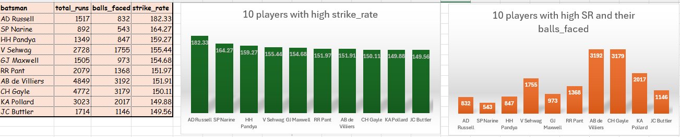
Visual representation of charts and tables
Based on the chart and table above, it is evident that the top ten players with high strike rates can be considered for the auction. We can choose 2 or 3 of them, as they have similar strike rates, which is crucial for aggressive batsmen. Additionally, all of these players have faced at least 500 balls. Therefore, we should consider them based on the prices at which they are placed.

Slide 6
2-3 players with good average and must have played 2 ipl season.
In order to identify players with a good batting average, we need to consider the following conditions: the total runs scored divided by the number of times the batsman has been dismissed.
The process can be outlined as follows:
Calculation dismissals and batting averages of each player
Identification of players who have played more than 2 IPL seasons and won player of the match.
Ranking the players by their batting averages and selection of the top 10 players using all these metrics

Slide 7
Codes for 2-3 players with good average and must have played 2 ipl season.
select batsman, SUM(batsman_runs) as total_runs, count(case when is_wicket = TRUE then 1 end) as dismissals from ipl_ball Group by batsman;
select batsman, sum(batsman_runs) as total_runs , count(case when is_wicket = TRUE then 1 end) as dismissals, (sum(batsman_runs)* 1.0/ Nullif(count(case when is_wicket = TRUE then 1 end),0)) as batting_average from ipl_ball Group by batsman;
SELECT b.batsman, COUNT(DISTINCT EXTRACT(YEAR FROM a.date)) AS ipl_season_played FROM ipl_matches1 AS a LEFT JOIN ipl_ball AS b ON a.id = b.id GROUP BY b.batsman HAVING COUNT(DISTINCT EXTRACT(YEAR FROM a.date)) > 2ORDER BY ipl_season_played DESC;

Slide 8
Codes for 2-3 players with good average and must have played 2 ipl season.
SELECT bs.batsman, bs.batting_average, bs.total_runs, bs.dismissals, sp.ipl_season_playedFROM ( SELECT b.batsman, SUM(b.batsman_runs) AS total_runs, COUNT(CASE WHEN b.is_wicket = TRUE THEN 1 END) AS dismissals, SUM(b.batsman_runs) * 1.0 / NULLIF(COUNT(CASE WHEN b.is_wicket = TRUE THEN 1 END), 0) AS batting_average FROM ipl_ball AS b GROUP BY b.batsman ) AS bsJOIN ( SELECT b.batsman, COUNT(DISTINCT EXTRACT(YEAR FROM a.date)) AS ipl_season_played FROM ipl_matches1 AS a LEFT JOIN ipl_ball AS b ON a.id = b.id GROUP BY b.batsman HAVING COUNT(DISTINCT EXTRACT(YEAR FROM a.date)) > 2 ) AS sp ON bs.batsman = sp.batsman ORDER BY bs.batting_average DESC LIMIT 10;

Slide 9
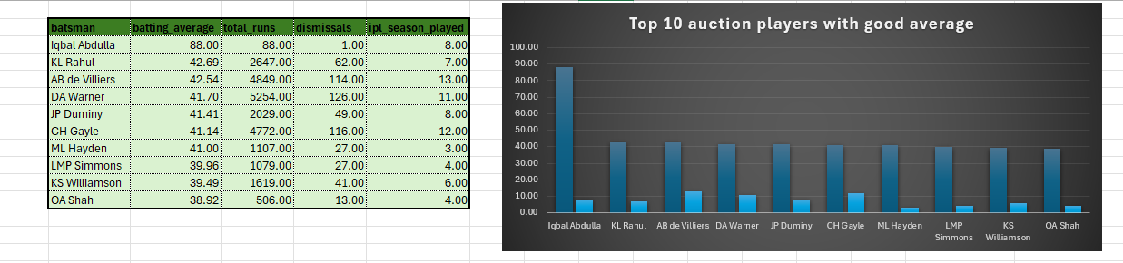
Visual representation of charts and tables
Based on the charts and graphs, we have identified the top 10 auction players with good averages who have played at least 2 IPL seasons. Given our finances, we can consider bidding for 2-3 of these players, as their averages are similar, except for Abdulla, who stands out with the best and widest margin among them.

Slide 10
2-3 Hard-hitting players who have scored most runs in boundaries and have played more than 2 ipl season
The goal is to find the top 10 hard-hitting players who have scored the most runs through boundaries and have participated in more than two IPL seasons. We will follow these steps to accomplish this:
Calculate the total number of boundaries (fours and sixes) for each player.
Determine the total runs scored by each player.
Calculate the boundary percentage for each player and take it into consideration.
Identify players who have played more than 2 IPL seasons. 5. Rank the players based on their boundary percentage and select the top 10 players.

Slide 11
Code for 2-3 Hard-hitting players who have scored most runs in boundaries and have played more the 2 ipl season.
select a.batsman ,a.total_runs,(a.runs_in_fours + a.runs_in_sixes) as boundaries_runs,(a.runs_in_fours + a.runs_in_sixes) * 1.0/a.total_runs as boundary_percentagefrom(select batsman,sum(case when batsman_runs = 4 then 4 else 0 end) as runs_in_fours,sum(case when batsman_runs = 6 then 6 else 0 end) as runs_in_sixes, sum(batsman_runs) as total_runs from ipl_ball Group by batsman ) aJoin ( select player_of_match as batsman, count(distinct extract(year from date)) as ipl_season_played from ipl_matches1 Group by player_of_match Having count(distinct extract(year from date)) > 2 ) b on a.batsman = b.batsman where a.total_runs > 0 order by boundary_percentage descLimit 10;

Slide 12
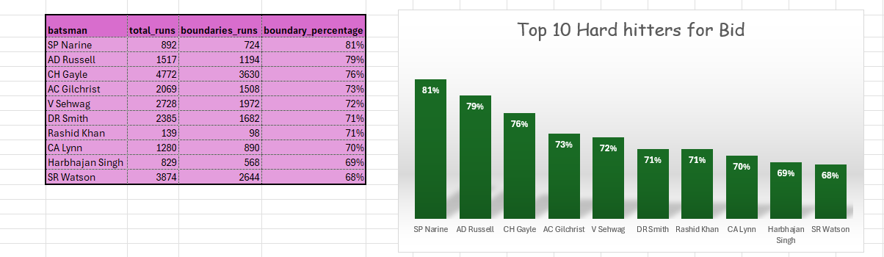
Visualization: Table and charts for hard-hitters
The following are the top ten hard hitters with the highest boundary percentages. From the chart, it is evident that the percentages are close. This makes it suitable for us to consider bidding for 2-3 players, depending on the funds available in our account. We could potentially bid for any of these great hard hitters.

Slide 13
First priority is to get 2-3 bowlers with good economy who have bowled at least 500 balls in IPL .
To achieve this, I need to follow these steps to identify bowlers in the IPL with good economy rates who have bowled at least 500 balls:
Determine the total number of balls bowled by each bowler.
Calculate the total runs given up by each bowler.
Compute the economy rate for each bowler.
Exclude bowlers who have bowled fewer than 500 balls.
Arrange the bowlers in order based on their economy rate.
Choose the top 10 bowlers

Slide 14
Code for First priority is to get 2-3 bowlers with good economy who have bowled at least 500 balls in IPL .
SELECT a.bowler, a.legitimate_balls AS balls_bowled, a.runs_conceded, (a.runs_conceded / (a.legitimate_balls / 6.0)) AS economy_rateFROM ( SELECT bowler, COUNT(*) AS bowled_balls, SUM(CASE WHEN extra_runs > 0 AND extras_type IN ('no_ball', 'wide') THEN 0 ELSE 1 END) AS legitimate_balls, SUM(total_runs) AS runs_conceded FROM ipl_ball GROUP BY bowler) AS aWHERE a.legitimate_balls >= 500ORDER BY economy_rate ASCLIMIT 10;

Slide 15
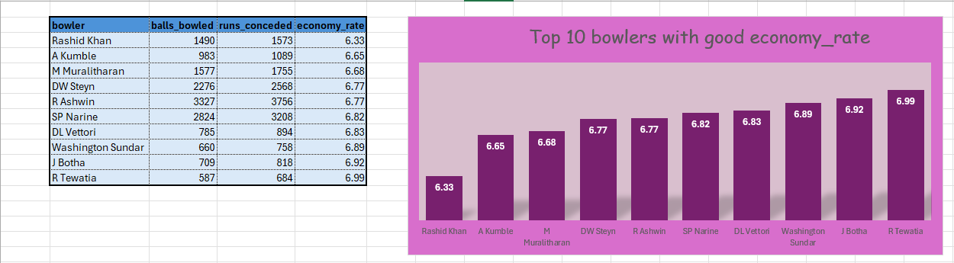
Visualization: charts and table for bowlers
The lower the economy rate, the better the bowlers. This chart and table show that the top 10 bowlers have a good economy rate and can be bid for in the auction among others. We can choose 2-3 from any of the 10 listed bowlers based on our finances and our budget.

Slide 16
The objective is to find 2-3 bowlers who have the best strike rate and have bowled at least 500 deliveries in the IPL.
To find bowlers with the top strike rates who have bowled at least 500 deliveries in the IPL,
Find out the total number of legitimate deliveries bowled by each bowler.
Determine the total number of wickets taken by each bowler.
Calculate the strike rate for each bowler (Strike rate = number of deliveries bowled / total wickets taken).
Only consider bowlers who have bowled at least 500 deliveries.
Rank the bowlers according to their strike rates.
Choose the top 10 bowlers based on their strike rates.

Slide 17
The code to find 2-3 bowlers who have the best strike rate and have bowled at least 500 deliveries in the IPL.
select * from ipl_ball;Select bowler, legitimate_balls as balls_bowled, wickets, (legitimate_balls * 1.0 / wickets) AS strike_ratefrom ( select bowler, sum(case when extra_runs > 0 and extras_type in ('no_ball', 'wide') then 0 else 1 end) as legitimate_balls, sum(case when dismissal_kind in ('bowled', 'caught', 'lbw', 'stumped', 'caught and bowled', 'hit wicket') then 1 else 0 end) as wicketsfrom ipl_ballGroup by bowler) as bowler_performance where legitimate_balls >= 500 order by strike_rate ASC LIMIT 10;

Slide 18
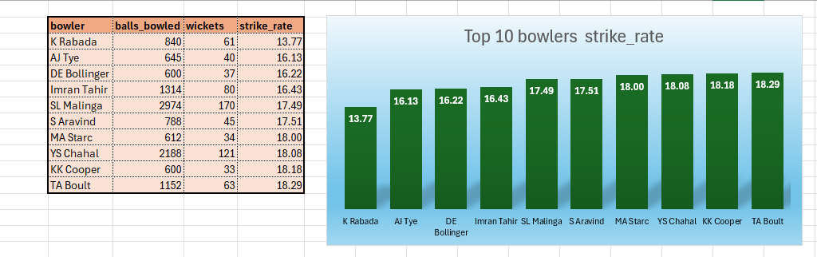
Visualization: charts and table for bowlers with best strike.
Similarly, the following bowlers have a good strike rate. The margin is not too large, and we can select 2-3 bowlers with a good strike rate from this top 10 list, considering our financial constraints.

Slide 19
To get 2-3 All_rounders with the best batting as well as bowling strike rate and who have faced at least 500 balls in IPL so far and have bowled minimum 300 balls
In order to identify the best all-rounders based on both batting and bowling strike rates among those who have batted at least 500 balls and bowled a minimum of 300 balls in the IPL, the following steps will be considered:
Calculate the batting strike rate for players who have faced at least 500 balls.
Compute the bowling strike rate for players who have bowled at least 300 balls.
Merge the outcomes to identify all-rounders meeting both criteria.
Choose the top 10 players based on their combined strike rates.

Slide 20
Code to get 2-3 All_rounders with the best batting as well as bowling strike rate and who have faced at least 500 balls in IPL so far and have bowled minimum 300 balls
select a.batsman as player, a.batting_strike_rate, b.bowling_strike_ratefrom ( select batsman, count(*) as balls_faced, sum(batsman_runs) as total_runs, (sum(batsman_runs) * 100.0 / count(*)) as batting_strike_ratefrom ipl_ballGroup by batsmanHaving count (*) >= 500) as ajoin ( select bowler, count(*) as balls_bowled, sum(case when dismissal_kind in ('bowled', 'caught', 'lbw', 'stumped', 'caught and bowled', 'hit wicket') then 1 else 0 end) as wickets, (count(*) * 1.0 / sum(case when dismissal_kind in ('bowled', 'caught', 'lbw', 'stumped', 'caught and bowled', 'hit wicket') then 1 else 0 end)) as bowling_strike_rate from ipl_ball Group by bowler Having count(*) >= 300) as b on a.batsman = b.bowlerorder by a.batting_strike_rate DESC, b.bowling_strike_rate ASC LIMIT 10;

Slide 21
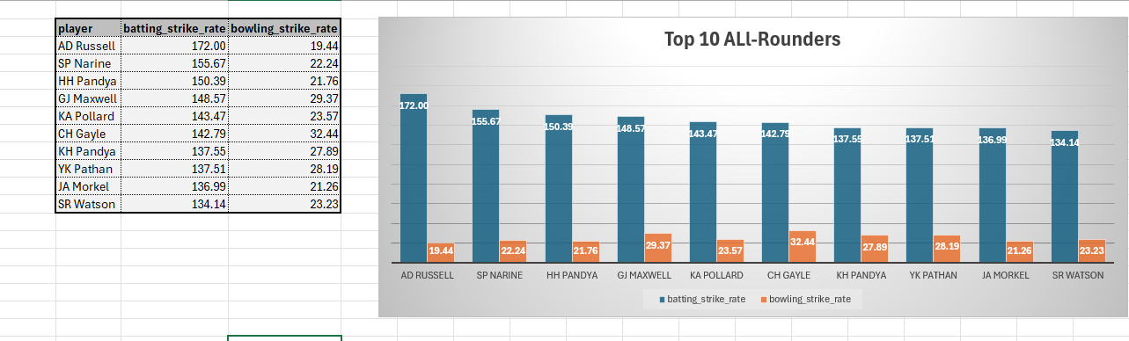
Visualization: Table and charts for All_Rounders
Based on the table and chart, the all-round players have slightly varying rates, but it is important to consider these rates when selecting 2-3 players from the top 10 for an auction, taking into account financial constraints and available funds.

Slide 22
Wicketkeepers Criteria for the best two wicket keepers
Batting Strike Rate: This shows the speed at which the batsman scores runs, and it's especially important in T20 cricket.
Batting Average: This indicates how consistent the batsman is in scoring runs.
Runs Scored: The total runs scored can give insight into the player's experience and their ability to contribute to the team's overall score.
Total dismissals (catches + stumpings) can reflect how well the wicketkeeper performs.
Stumping rate is especially significant in T20 matches, as fast stumpings can have a significant impact on the game.

Slide 23
Additional Questions for final assessment
Deliveries table query
CREATE TABLE deliveries ( id INT, inning INT, over INT, ball INT, batsman VARCHAR, non_striker VARCHAR, bowler VARCHAR, batsman_runs INT, extra_runs INT, total_runs INT, is_wicket BOOLEAN, dismissal_kind VARCHAR, player_dismissed VARCHAR, fielder VARCHAR, extras_type VARCHAR, batting_team VARCHAR, bowling_team VARCHAR);
insert into deliveries
select *from ipl_ball;

Slide 24

Additional Questions for final assessment
select count(distinct city) as city_count from ipl_matches1;
2. create table deliveries_v02 as select *, case when total_runs >= 4 then 'boundary' when total_runs = 0 then 'dot' Else 'other' end as ball_result from deliveries;
select * from deliveries_v02;

Slide 25
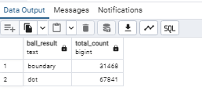
Question 3
select ball_result, count(*) as total_count from deliveries_v02where ball_result IN ('boundary', 'dot’) Group by ball_result;

Slide 26
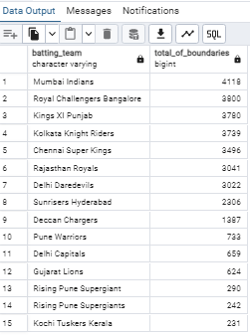
Question 4
select batting_team, count(*) as total_of_boundariesfrom deliveries_v02where ball_result = 'boundary'Group by batting_team order by total_of_boundaries desc;

Slide 27
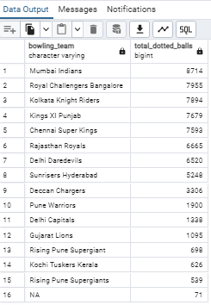
Question 5
select bowling_team, count(*) as total_dotted_ballsfrom deliveries_v02where ball_result = 'dot’ Group by bowling_team order by total_dotted_balls Desc;

Slide 28
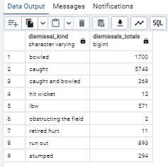
Question 6
select dismissal_kind, count(*) as dismissals_totals from deliveries where dismissal_kind != 'NA' Group by dismissal_kind;

Slide 29
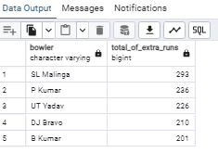
Question 7
select bowler, sum(extra_runs) as total_of_extra_runs from deliveries Group by bowler order by total_of_extra_runs Desc Limit 5;

Slide 30
Question 8
create table deliveries_v03 as select a.*, b.venue, b.date as match_date from deliveries_v02 ajoin ipl_matches1 b ON a.id = b.id;
select * from deliveries_v03;

Slide 31
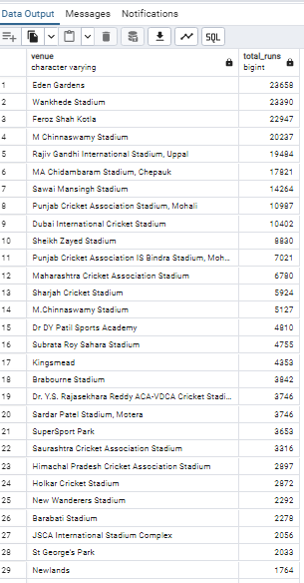
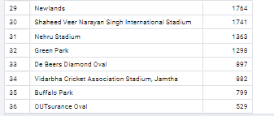
Question 9
select venue, sum(total_runs) as total_runsfrom deliveries_v03 Group by venue order by total_runs DESC;

Slide 32
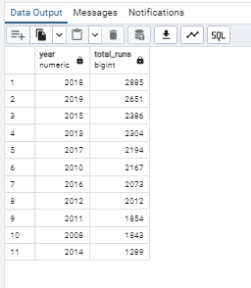
Question 10
Select extract(YEAR FROM match_date) as year, sum(total_runs) as total_runsfrom deliveries_v03where venue = 'Eden Gardens'Group by year order by total_runs Desc;

